Slide 1
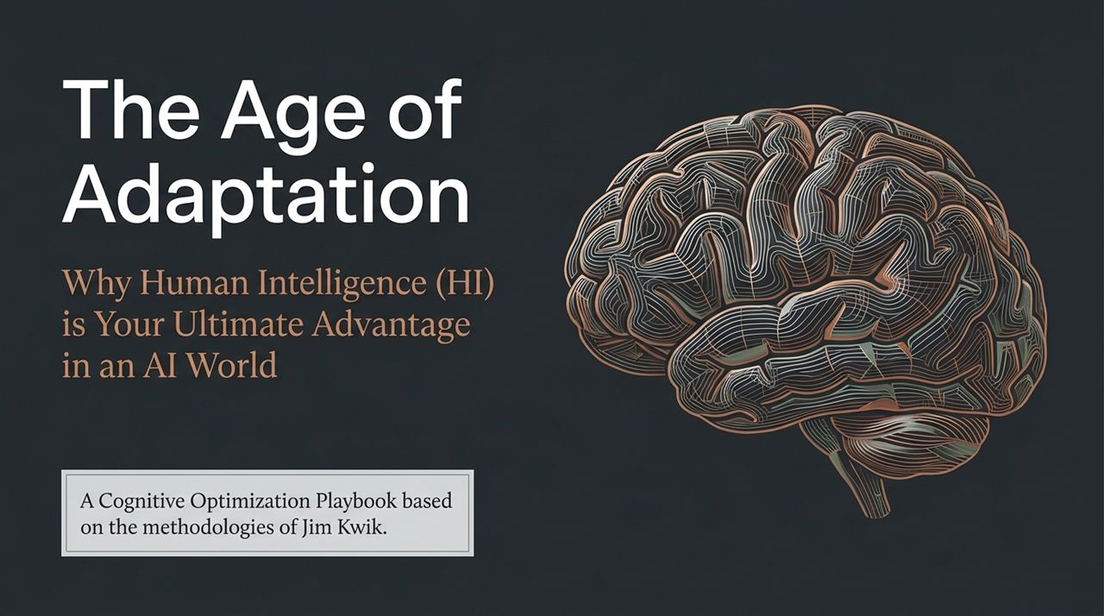
Notes:
Welcome, everyone. Look around at the current technological landscape. Every single day, we are bombarded with news about Artificial Intelligence: how fast it’s advancing, how many tasks it can automate, and how it might change or replace our jobs. It’s easy to feel overwhelmed, or worse, obsolete.
But today, we are changing the narrative. Welcome to The Age of Adaptation.
Our core premise today is simple: AI is not here to replace human intelligence (HI); it is here to test it, scale it, and highlight what makes us irreplaceable. The real competitive advantage in an AI-driven world isn't having access to better software—everyone has access to the same tools. Your real advantage is your cognitive operating system: how you process, adapt, focus, and create.
Based on the proven methodologies of cognitive performance expert Jim Kwik, this playbook will guide you through optimizing your brain's architecture. We are going to strip away the false labels you've placed on your mental capacity and build a strategy that makes your mind sharper, more resilient, and ultimately limitless. Let’s step out of the fear of automation and into the power of human adaptation.
https://www.youtube.com/watch?v=rMjVAnHmUeE

Slide 2
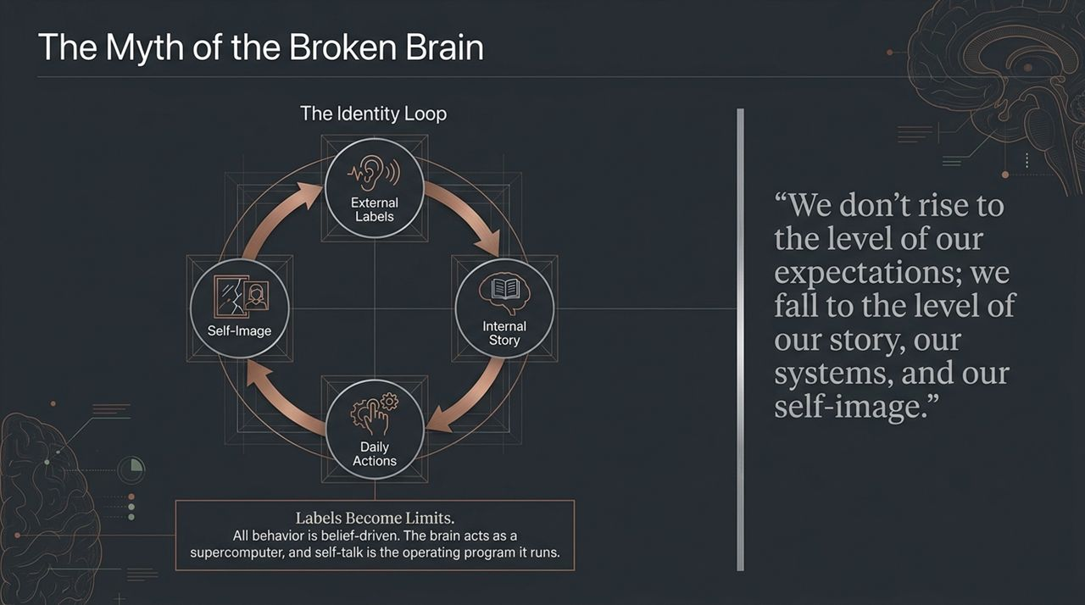
Notes:
Let’s start with a foundational truth: most people don't have a broken brain; they have a broken mindset or a broken system.
Many of us carry labels from our childhood or past failures. Maybe a teacher told you that you were 'bad at math,' or you convinced yourself that you have a 'terrible memory' or 'can't focus.' Jim Kwik emphasizes a vital truth: If you fight for your limitations, you get to keep them.
Take a look at The Identity Loop on this slide. It shows how our reality is constructed:
External Labels: Someone calls us slow, disorganized, or non-technical.
Internal Story: We absorb that label and repeat it to ourselves. 'I'm just not a tech person.'
Daily Actions: Because we believe that story, our actions align with it. We don't try hard, we hesitate, and we give up quickly.
Self-Image: Those weak actions reinforce our self-image, confirming the original external label.
All human behavior is belief-driven. Your brain is the ultimate supercomputer, and your self-talk is the code it runs. If you program your mind with 'I can't remember names' or 'I am overwhelmed by AI,' your brain's search engine will look for evidence to prove you right.
To upgrade your intelligence, you must break the loop. Stop feeding the story you don't want. Shift your self-talk, upgrade your system, and realize that your labels are not your limits.

Slide 3
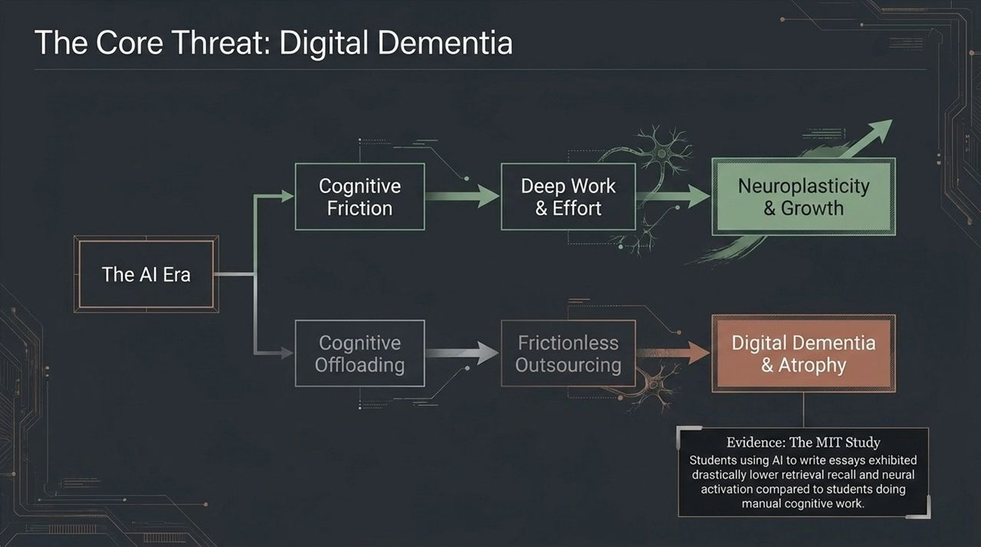
Notes:
We are at a critical fork in the road created by the AI era. Look at the two paths on this slide.
Path A is Cognitive Friction. When you wrestle with a complex problem, read a difficult paper, or do manual mental work, you experience friction. That effort triggers neuroplasticity—your brain’s ability to rewire itself and build stronger neural pathways. Effort is the precise mechanism of mental growth.
Path B is Cognitive Offloading, and it leads straight to what neuroscientists call Digital Dementia. Digital Dementia is the breakdown of cognitive abilities due to the over-reliance on digital technology. When we outsource every piece of thinking, memory, and writing to devices or AI models without doing the mental heavy lifting first, our brains atrophy.
Consider the MIT study cited here. Researchers evaluated students using AI to draft essays versus students doing manual cognitive work. The AI group showed drastically lower neural activation and significantly poorer memory retrieval. They weren't learning; they were merely translating outputs.
Think of your brain like a muscle. If you use an electric wheelchair every day instead of walking, your legs will eventually wither. If you use AI to do all your thinking, your cognitive capacity will shrink. AI should be an extension of your mind, not a replacement for it. Use it to enhance your output, but do not let it replace the deep work that keeps your brain alive.

Slide 4
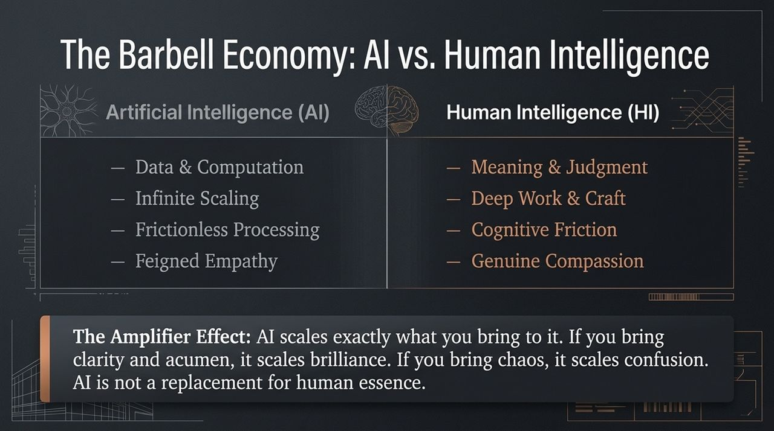
Notes:
To navigate the modern economy, we must understand the fundamental difference between Artificial Intelligence and Human Intelligence. We can think of this as a barbell, with two very distinct weights on either end.
On one side, AI excels at Data, Computation, Infinite Scaling, and Frictionless Processing. It can analyze millions of data points in seconds. It can even generate polite responses—what we call feigned empathy.
On the other side, Human Intelligence is where Meaning, Judgment, Deep Work, Craft, and Genuine Compassion reside. AI can synthesize information, but it cannot care. It cannot feel loss, it cannot build true trust, and it lacks contextual wisdom.
This leads us to the Amplifier Effect: AI is an amplifier. It multiplies whatever you feed into it.
If you bring clarity, domain expertise, and strategic acumen to an AI tool, it scales your brilliance 10x.
If you bring chaos, vagueness, and lazy thinking, it simply scales confusion at hyper-speed.
AI is not a replacement for human essence; it is a force multiplier. Your goal is not to compete with machines on data processing—you will lose that battle. Your goal is to sharpen your uniquely human traits so that when you use AI, you amplify mastery rather than mediocrity.

Slide 5
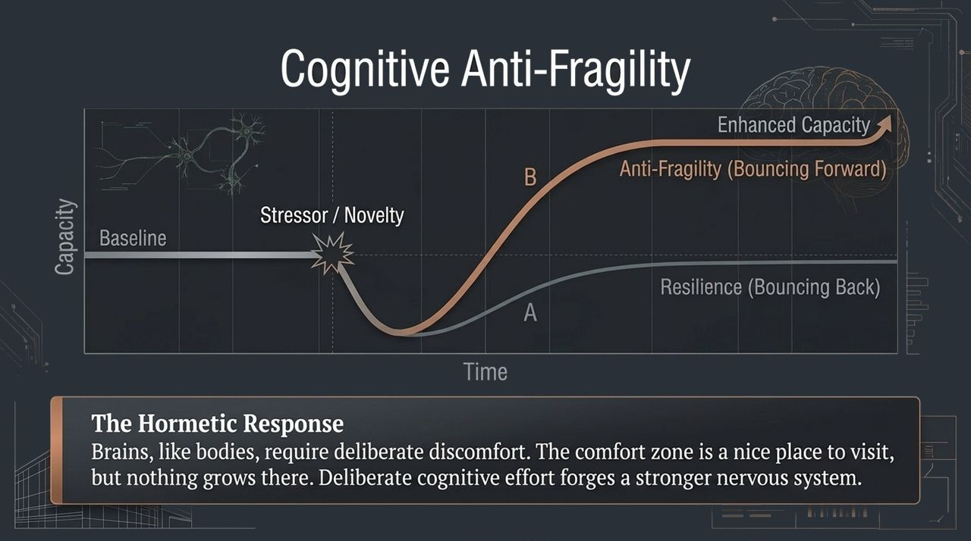
Notes:
How do you respond when faced with massive technological disruption or high-stress environments? Most people talk about resilience. But resilience isn't enough anymore.
Look at the graph on this slide.
Line A represents Resilience: Resilience is the ability to bounce back to your original baseline after a shock. You take a hit, you recover, and you are back where you started.
Line B represents Anti-Fragility: Coined by Nassim Taleb, anti-fragility means bouncing forward. It is the property of systems that get stronger when subjected to stress, novelty, and tension.
In biology, this is known as hormesis. When you lift heavy weights at the gym, you create microscopic tears in your muscle fibers. That is a stressor. But with proper recovery, the muscle doesn't just heal back to its original size—it grows larger and stronger to prepare for future stress.
Your brain operates on the exact same principle. Comfort is the enemy of cognitive growth. If your daily life is entirely frictionless—if you avoid challenging tasks, hard conversations, and complex learning—your mental capacity shrinks.
When new tech or disruptions threaten your routine, don't wish for it to be easier. Adopt an anti-fragile mindset. View every cognitive stressor as a gym workout for your neurons. Welcome deliberate mental discomfort, because that is where enhanced capacity is forged.

Slide 6
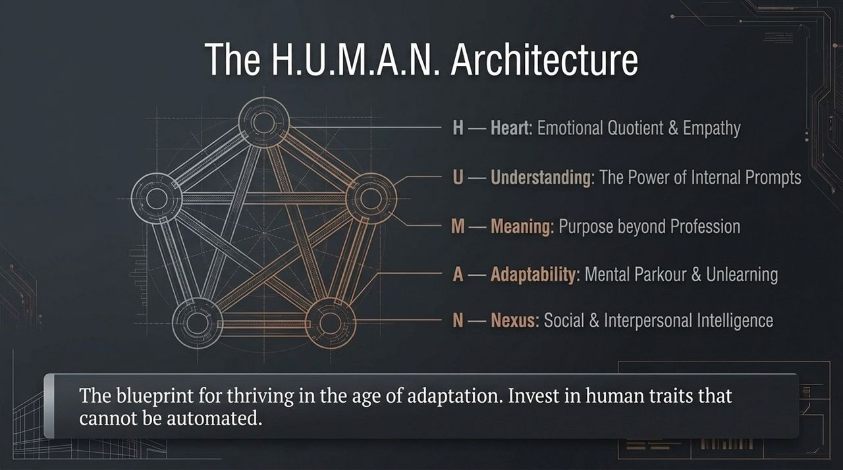
Notes:
To stay indispensable in an automated world, we need a blueprint. I call this the H.U.M.A.N. Architecture—a 5-part framework representing the core human capacities that technology cannot replicate.
H – Heart (Emotional Quotient & Empathy): The ability to connect deeply, understand unexpressed human needs, and lead with compassion.
U – Understanding (Internal Prompts): The depth of your curiosity and self-awareness. The outputs of your life depend on the quality of the questions you ask yourself.
M – Meaning (Purpose beyond Profession): Machines run on directives; humans run on purpose. Meaning is what drives perseverance, ethical decision-making, and long-term vision.
A – Adaptability (Mental Parkour & Unlearning): The ability to bend without breaking. Learning is important, but in a fast-changing world, the ability to unlearn outdated models is even more critical.
N – Nexus (Social & Interpersonal Intelligence): Understanding network dynamics, team synergy, and how humans co-regulate and collaborate under pressure.
As you look at your own professional development, ask yourself: Am I spending all my time learning technical skills that an AI update could make obsolete next month, or am I investing in my H.U.M.A.N. architecture? Double down on these five pillars, and you will build a career that is completely future-proof.

Slide 7
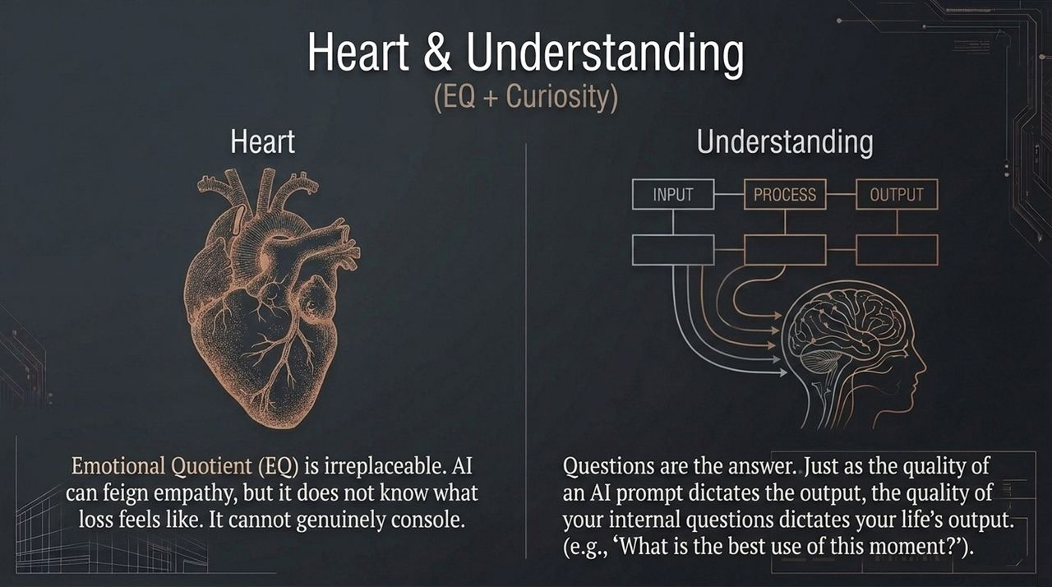
Notes:
Let’s unpack the first two pillars of our framework: Heart and Understanding.
First, Heart. We live in a world obsessed with IQ, but EQ—Emotional Quotient—is what builds cultures, closes deals, and resolves crises. AI can generate text that sounds sympathetic, but it lacks an organic emotional center. It doesn't know fear, joy, grief, or triumph. In leadership and client relationships, people can sense authentic human empathy. Never underestimate the commercial and personal value of genuine human care.
Second, Understanding, which relies on curiosity and the power of internal prompts.
We talk a lot about 'Prompt Engineering' for AI—how asking LLMs better questions yields better answers. But what about your internal prompt engineering? Look at the input-process-output diagram on this slide. Your brain is continuously running background scripts based on the questions you ask it.
If you ask bad questions like, 'Why is this happening to me?' or 'Why am I so bad at this?', your brain processes that input and delivers negative outputs. But if you ask high-leverage questions like, 'What is the lesson here?' or 'How can I use this constraint to innovate?', your cognitive processing completely shifts.
Mastering your mind begins with mastering the internal questions you run every single day.

Slide 8
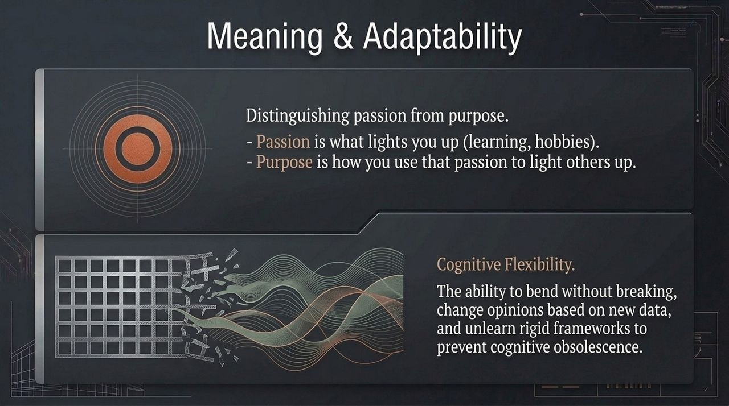
Notes:
Moving to our next two pillars: Meaning and Adaptability.
First, let's distinguish between two concepts that people often mix up: Passion and Purpose.
Passion is selfish—in a healthy way. Passion is what lights you up. It’s your interest in reading, coding, art, or psychology.
Purpose, however, is selfless. Purpose is how you use your passion to light others up. When you anchor your daily work in purpose—asking how your efforts serve your team, your clients, or your community—you tap into an extraordinary reservoir of motivation that burnout cannot touch.
Next is Adaptability, or Cognitive Flexibility. Look at the visual on the slide: on the left, you have a rigid, static grid. When hit by a force, it shatters. On the right, you have flexible, fluid waves that adapt to incoming currents.
In an AI world, rigid frameworks lead to cognitive obsolescence. If you hold onto 'the way we’ve always done it,' you become fragile. Adaptability requires mental parkour—the willingness to hold your beliefs lightly, embrace new data, and pivot instantly. Don't fall in love with your tools or your past methods; fall in love with the problem you are solving.

Slide 9
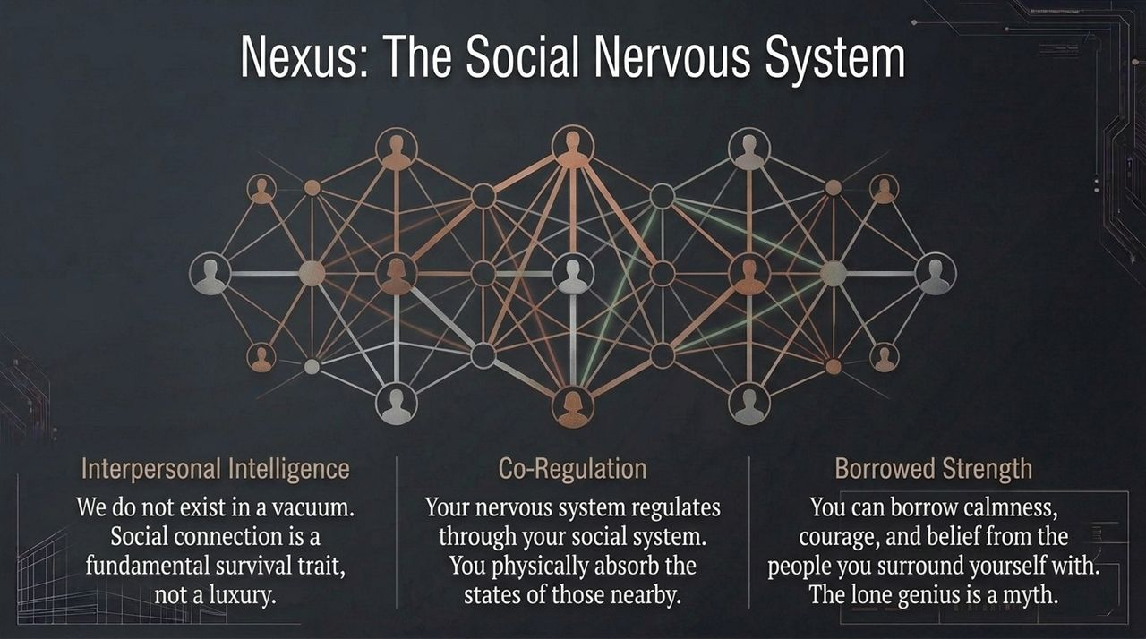
Notes:
The fifth pillar of the H.U.M.A.N. architecture is Nexus: our social and interpersonal intelligence.
Western culture often celebrates the myth of the 'lone genius'—the solitary worker who solves massive problems in isolation. But neuroscience tells a completely different story. Human beings do not exist in a vacuum; our nervous systems are designed to operate as a network.
Three key principles define the Nexus:
Interpersonal Intelligence: Social connection isn't just a nice-to-have social activity; it is a fundamental evolutionary survival trait.
Co-Regulation: Your autonomic nervous system physically reacts to the nervous systems around you. If you enter a room full of stressed, panicked people, your body absorbs that tension. Conversely, a calm, grounded leader can instantly de-escalate an entire team's panic.
Borrowed Strength: When your internal drive is low, you can temporarily borrow clarity, courage, and conviction from your network.
Surround yourself with people who challenge your standards and elevate your thinking. The ultimate cognitive ecosystem isn't just your individual brain—it’s the collective intelligence and emotional stability of the group you build around you.

Slide 10
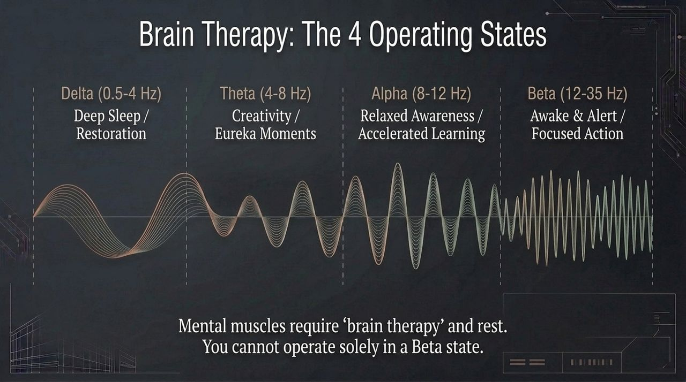
Notes:
To get peak performance out of your mind, you need to understand your brain’s operating frequencies. Your brain operates in four main wave states, each serving a unique function:
Beta (12–35 Hz): Awake, alert, and focused on active tasks. This is where you write code, analyze reports, and hold tactical meetings. While necessary, staying in high Beta for too long leads to stress, anxiety, and eventual burnout.
Alpha (8–12 Hz): Relaxed awareness. This is the state of deep flow, rapid learning, and accelerated information absorption. Athletes call it 'the zone.'
Theta (4–8 Hz): The state of deep creativity, visualization, and eureka moments. It occurs during light sleep, meditation, or those moments in the shower when solutions suddenly pop into your mind.
Delta (0.5–4 Hz): Deep, dreamless sleep. This is where physical healing, memory consolidation, and brain detoxification take place.
Most modern professionals try to run in Beta 16 hours a day, driven by caffeine and notifications, and then crash into Delta. They completely skip Alpha and Theta.
Mental muscles require deliberate recovery—what Jim Kwik calls 'Brain Therapy.' If you want high-level insights and fast learning, you must design downtime into your day to allow your brain to cycle into Alpha and Theta states.

Slide 11
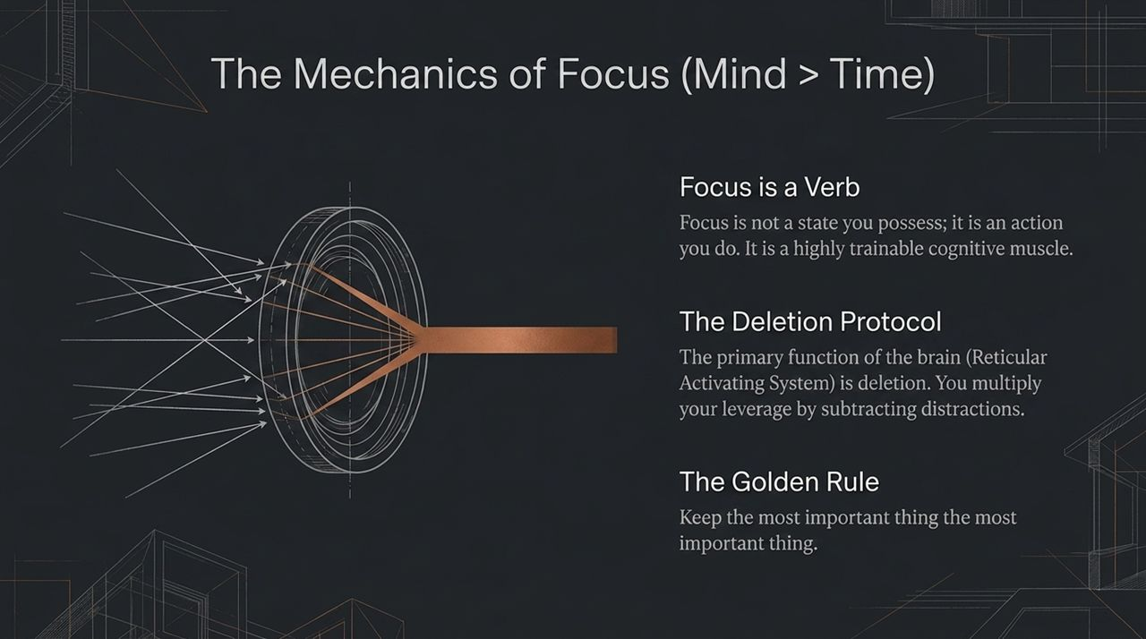
Notes:
We often hear people say, 'I just can't focus today.' As if focus is a weather condition that happens to you.
Jim Kwik teaches us that Focus is a Verb. It is not a state you possess or inherit; it is an action you perform. And like any muscle, it can be trained or weakened depending on how you use it.
To master focus, you must understand your brain's filtering hardware: the Reticular Activating System (RAS). Your brain receives millions of bits of information every second. If it processed everything, you would lose consciousness from sensory overload. So, the primary job of the RAS is deletion—filtering out useless data so you can focus on what matters.
This gives us The Deletion Protocol: High performance isn't about doing more; it’s about subtracting distractions.
Turn off non-essential notifications.
Clear your physical workspace.
Close the 40 open browser tabs competing for your attention.
Remember the Golden Rule of Cognitive Leverage: Keep the most important thing the most important thing. Stop managing your time, and start managing your focus.

Slide 12
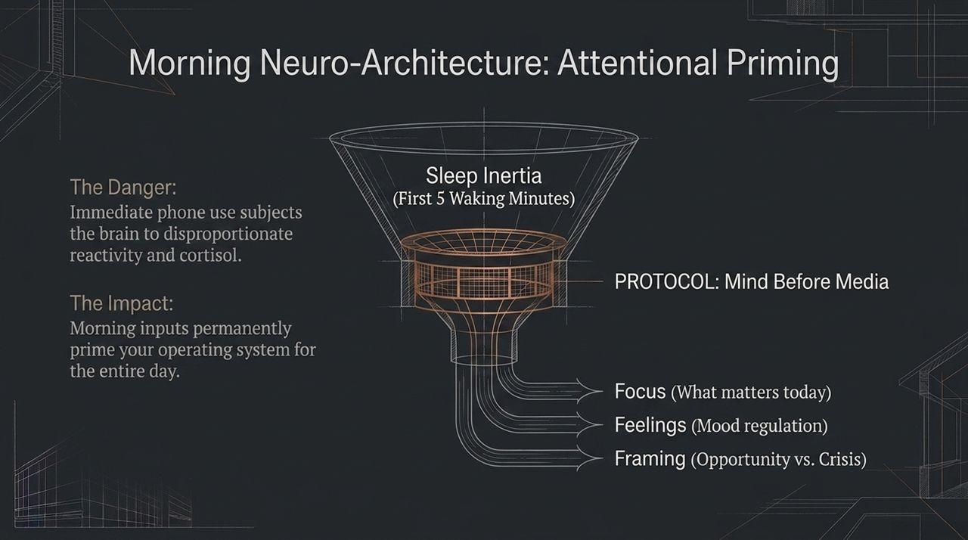
Notes:
Let's talk about the single most destructive habit in modern society: checking your smartphone within the first five minutes of waking up.
When you wake up, your brain transitions out of Delta and Theta states through a window called Sleep Inertia. During this time, your brain is exceptionally neuroplastic and highly suggestible.
If you grab your phone immediately, you subject your mind to two main dangers:
Cortisol Spike: Seeing work emails, bad news, or social media updates triggers an immediate fight-or-flight stress response.
Reactive Conditioning: You prime your brain to spend the rest of the day reacting to other people's agendas rather than focusing on your own goals.
Instead, implement the 'Mind Before Media' protocol. Protect the first 20 to 30 minutes of your morning to prime your attentional engine across three dimensions:
Focus: Identify the 1 to 3 critical things that actually matter today.
Feelings: Engage in mood regulation through breathing, gratitude, or light movement.
Framing: Consciously choose your perspective—viewing today’s challenges as opportunities for growth rather than a crisis to survive.
How you start your morning sets the operating system for the rest of your day. Win the morning, win the day.

Slide 13
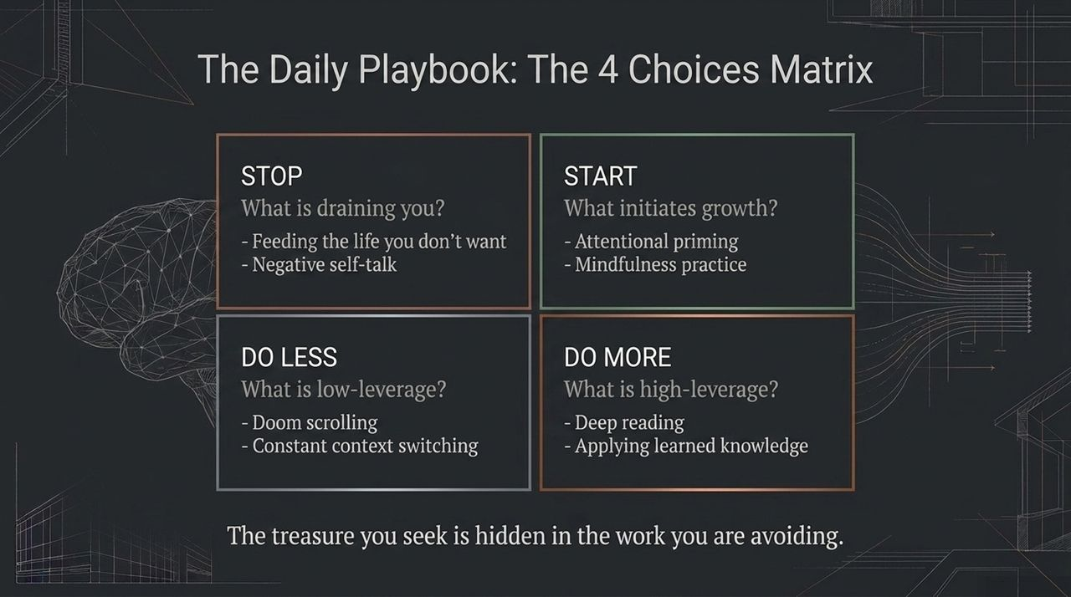
Notes:
To translate these principles into daily action, use The 4 Choices Matrix. This simple audit helps clean up your daily mental schedule:
STOP: Identify what is draining your cognitive reservoir. Stop feeding self-limiting stories, stop engaging in toxic self-talk, and stop opening apps that add no value to your life.
START: Introduce high-leverage growth practices. Start your morning with 'Mind Before Media,' adopt a daily 10-minute mindfulness practice, or keep a daily learning journal.
DO LESS: Cut back on low-leverage activities that fragment your focus. Reduce doom-scrolling, minimize multi-tasking, and avoid jumping between context-heavy tasks every 5 minutes.
DO MORE: Double down on high-leverage activities. Read deeply, practice active recall, apply new knowledge immediately, and prioritize restorative movement.
Take a look at the quote at the bottom of the slide: 'The treasure you seek is hidden in the work you are avoiding.'
We often know exactly what task will move the needle, but we avoid it because of the cognitive friction involved. Apply this matrix daily to stop wasting energy on noise and direct it toward high-impact work.

Slide 14
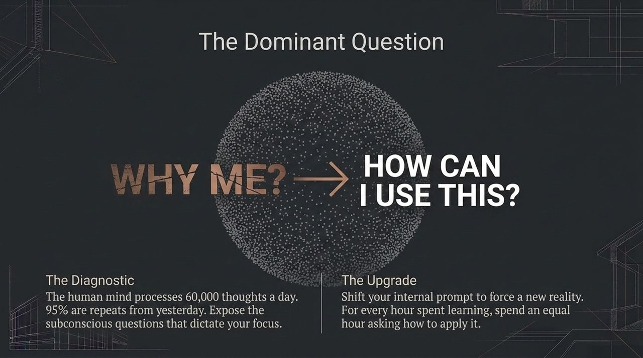
Notes:
Neuroscientists estimate that the human mind processes roughly 60,000 thoughts per day. What’s alarming is that for most people, 95% of those thoughts are identical to the thoughts they had yesterday. We run in loops.
At the core of these loops lies your Dominant Question. This is an overarching, often subconscious query that your Reticular Activating System works around the clock to answer.
Consider someone whose dominant question is: 'Why does bad luck always happen to me?' Their brain will constantly highlight every delay, minor insult, and failure to answer that question.
Look at the shift on the slide:
Move away from diagnostic, victim-oriented questions like 'WHY ME?'
Shift to agency-driven, constructive questions like 'HOW CAN I USE THIS?'
When you shift to 'How can I use this constraint to build a better solution?', your brain instantly drops the pity party and starts scanning your environment for tools, possibilities, and strategies.
Furthermore, adopt Jim Kwik’s 1:1 rule: For every hour you spend consuming information, spend an equal hour asking how to apply it. Information without application leads to mental constipation. Always ask: How do I use this right now?

Slide 15
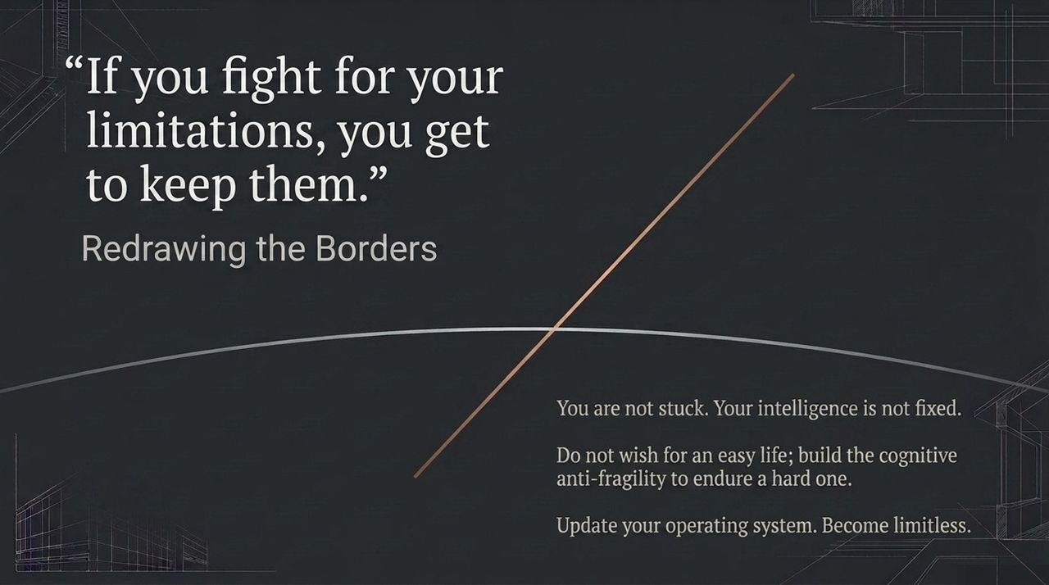
Notes:
As we begin to bring these ideas together, look at this powerful quote: 'If you fight for your limitations, you get to keep them.'
It’s time to redraw your mental borders. Your intelligence, memory, and focus are not static traits set at birth—they are dynamic, trainable capabilities.
Neuroplasticity proves that as long as you are alive, your brain can form new connections, adapt to complex demands, and master new skills. The only thing standing in the way is an outdated operating system built on self-limiting stories.
Do not wish for a simple, static life with zero complexity; build the cognitive anti-fragility to thrive in an unpredictable world.
When tech shifts, adapt. When facing a complex problem, lean into the cognitive friction. Upgrade your internal prompts, protect your morning focus, and commit to continuous growth. You are not stuck—you are simply due for an operating system update. Become limitless.

Slide 16
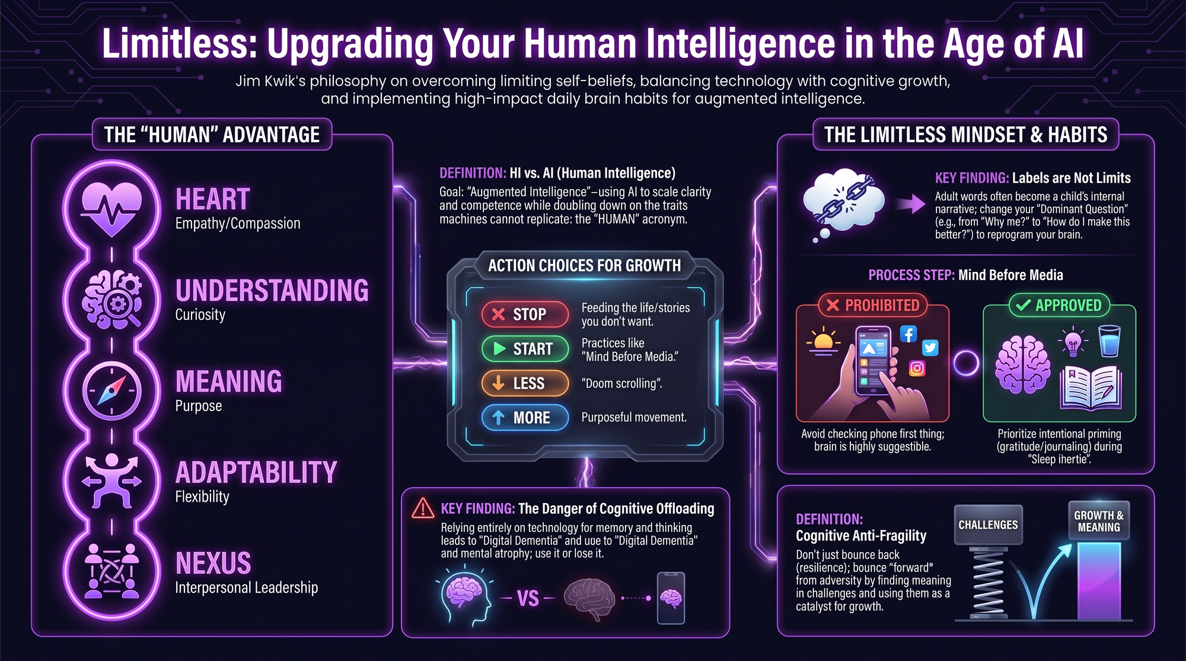
Notes:
To wrap up our session, let’s look at our complete summary blueprint for mastering Human Intelligence in the Age of AI.
Here is your quick-reference action guide:
The Goal: Build Augmented Intelligence. Use AI to handle scale, speed, and raw data processing, while doubling down on your core human traits—the H.U.M.A.N. acronym (Heart, Understanding, Meaning, Adaptability, and Nexus).
The Warning: Beware of cognitive offloading. Relying entirely on technology for basic thinking and memory leads to Digital Dementia. Treat your mind like a muscle: use it or lose it.
The Daily Protocol: Implement Mind Before Media during sleep inertia. Protect your morning attention to avoid reactive stress and keep your focus clear.
The Mindset: Cultivate Cognitive Anti-Fragility. Don't just recover from challenges—bounce forward, learn from the friction, and use every disruption as fuel for growth.
The Daily Matrix: Regularly evaluate your habits—Stop feeding negative stories, Start daily priming, do Less mindless scrolling, and do More deep reading and intentional practice.
AI isn't the end of human leverage; it's the ultimate proving ground for it. Upgrade your mindset, optimize your habits, and step confidently into your human advantage. Thank you!

